Slide 1

Module 2
Exploratory Data Analysis (EDA)
Notes:
Guidelines
Use section headers to chunk content in your presentation.
Use the same style of section header throughout your presentation.
Keep your title to no more than 2 lines.

Slide 2

EDA – Summaries and Basic Plots
Notes:
Guidelines
Use a title slide at the beginning of your presentation. There are 9 variations of title slides to choose from.
If you will have a series of slideshows, we recommend using the same style of title slide for each presentation.
Keep your title to no more than 2 lines.
Do not change the font style or font size of the title or subtitle.

Slide 3
Purpose of Exploratory Data Analysis
Analyzing variables individually (univariate)
Number of variables
Categorical variables with too many levels
Categorical variables with 1 level
% of missing values
Summary statistics
Data shapes
Variable types
Variables to remove for irrelevance
Extreme values

Slide 4
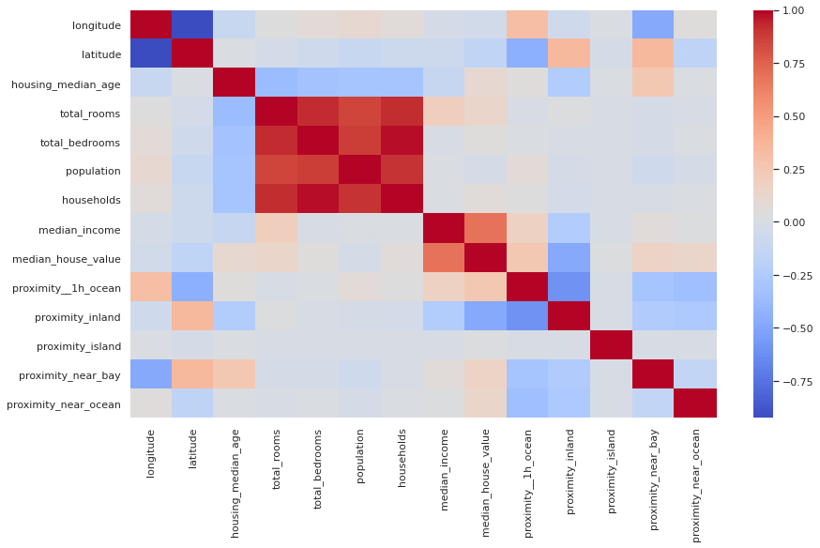
Purpose of Exploratory Data Analysis
Analyzing joint relationships (multivariate)
Relationships with response
Multi-collinearity

Slide 5

Veterans Data
A national veterans’ organization seeks to better target its solicitations for donation.
Goal: solicit the most likely donors
Solicitations involve sending a small gift
The organization has more than 3.5 million individuals in database

Slide 6
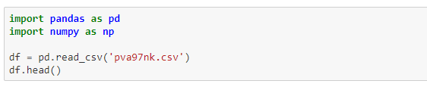
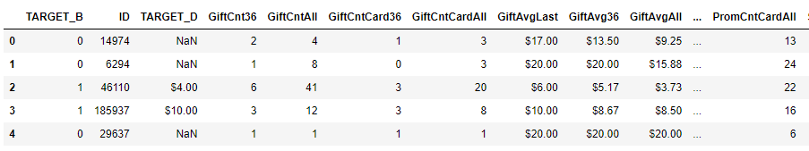
Veterans Data
Dataset:

Slide 7
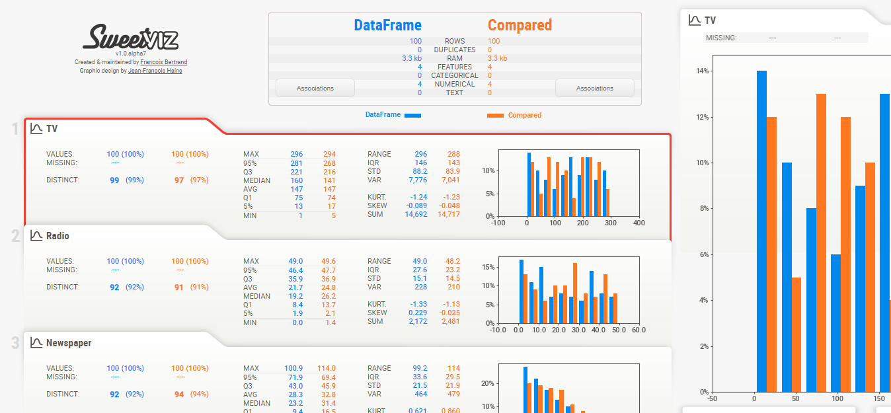
Automated EDA
Modules: pandas_profiling,AutoViz,summarytools

Slide 8
Python
Notes:
Guidelines
Use a title slide at the beginning of your presentation. There are 9 variations of title slides to choose from.
If you will have a series of slideshows, we recommend using the same style of title slide for each presentation.
Keep your title to no more than 2 lines.
Do not change the font style or font size of the title or subtitle.

